Slide 1
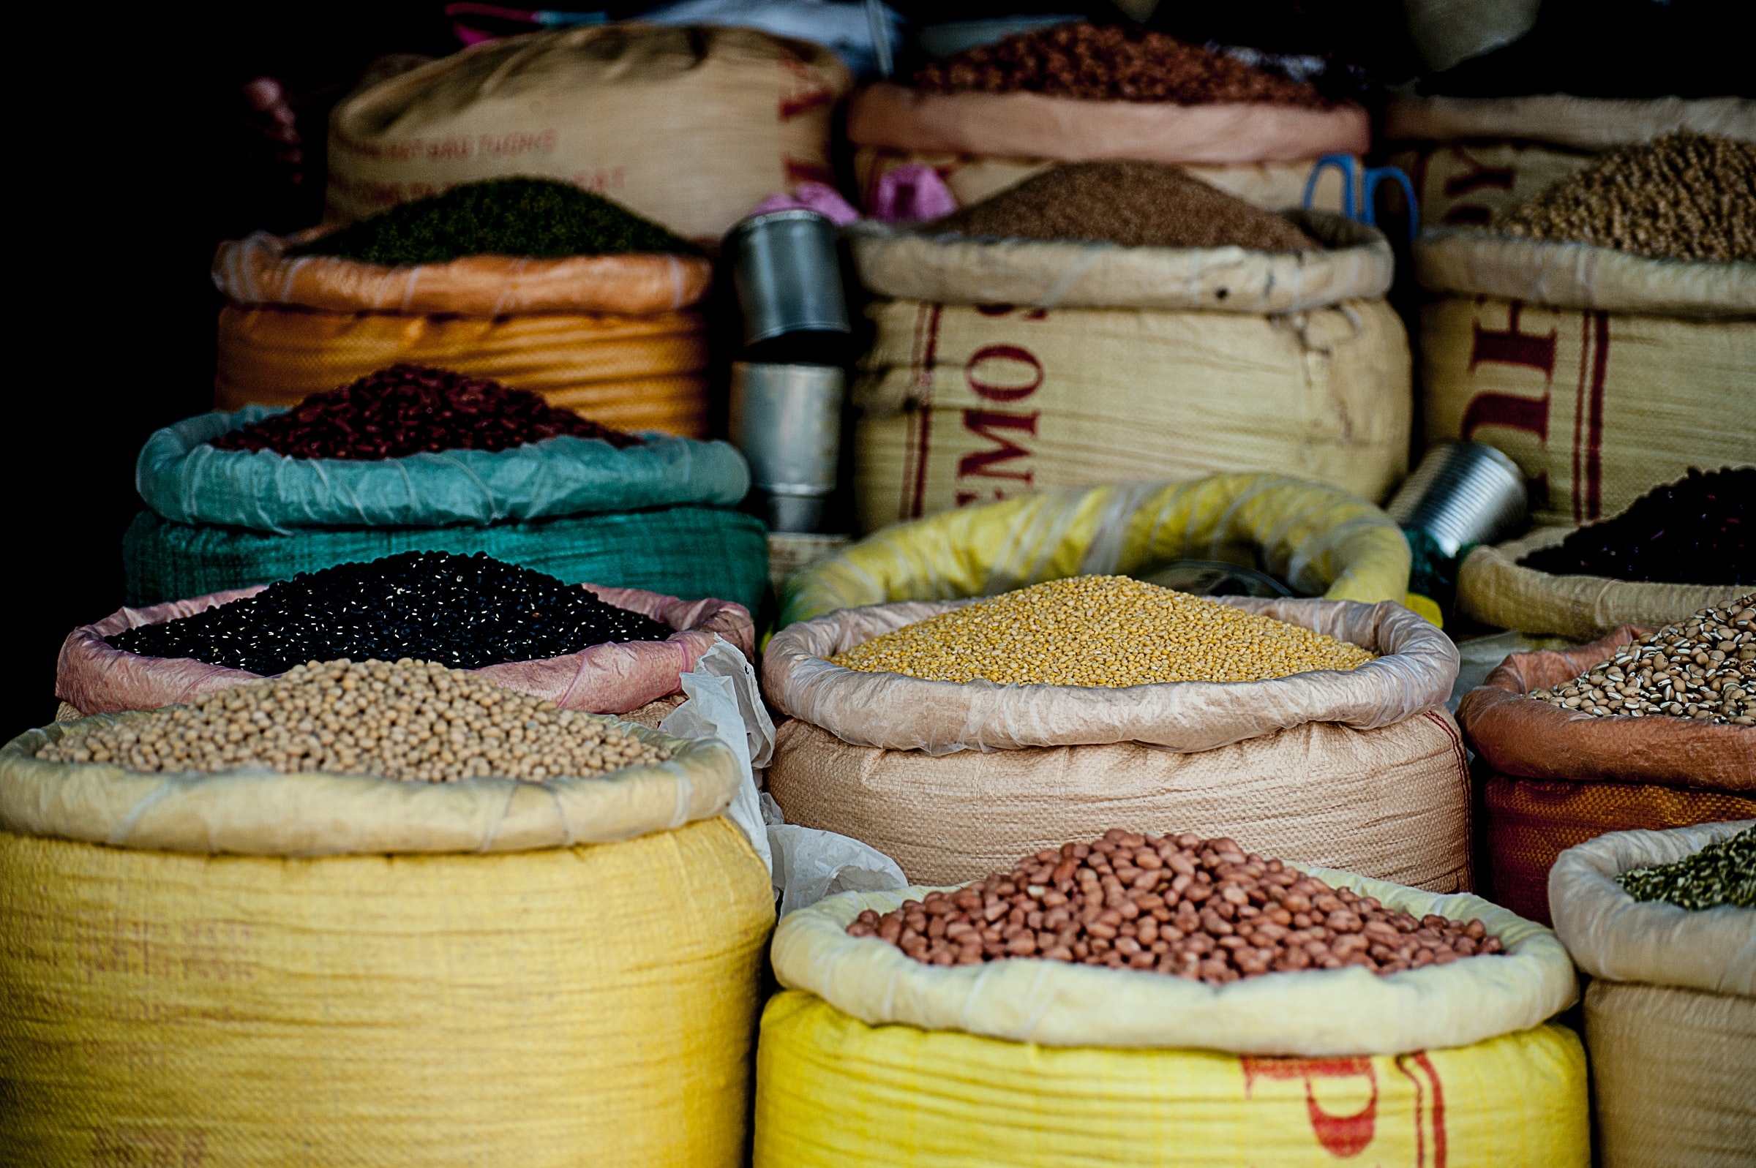

Governing crop genetics: Ownership, control and circulation of suitable seeds
Startside 1
Kathmandu Seminar
2 November, 2022
Presenting results from the research project
Suitable Seeds for Food Security in Fragile States
Photo: v2osk
on Unsplash
Notes:
We have now come to the presentation of the case study of Indian seeds legislation, which is a central part of the suitable seeds project.

Slide 2
Regulated Germplasm Exchange: Impacts on Seeds Legislation in India
Startside 1
Kathmandu seminar. Project on Suitable seeds
2 November, 2022
Vibha Dhawan (TERI), Arvind Kapur (Acsen HyVeg), Kritika Khanna (CABI), Kristin Rosendal (FNI)
Photo: v2osk
on Unsplash
Notes:
The central question addressed in this study is:
How are seed policies in India affected by recent technological developments and international obligations stemming from trade and environmental regimes?

Slide 3
Authors
Dr Vibha Dhawan, TERI, India; Plant Biotechnology
Dr Arvind Kapur, Acsen HyVeg; plant biochemistry
Kritika Kanna, CABI; Economics and business management
Dr Kristin Rosendal, FNI; research professor in political science
Notes:
Let me first introduce the authors:
Dr Vibha Dhawan is Director General of the Energy and Resources Institute (TERI) in India. Her academic background is in Plant Biotechnology.
Dr Arvind Kapur is the Managing Director of Acsen HyVeg. He holds a Ph.D. in Plant Biochemistry from Punjab Agricultural University Ludhiana.
Kritika Khanna, Economics and Business Management, is a Business Development and Communications Officer with the Centre for Bioscience and Agriculture International (CABI).
Dr Kristin Rosendal is a Research Professor at the Fridtjof Nansen Institute (FNI), where she has also served as Research Director and Deputy Director. She holds a PhD in Political Science from the University of Oslo.

Slide 4
Content
Introduction
Diversity and germplasm exchange in plant breeding
Analytical and methodological approach
International regulations and actors
Domestic seeds legislation
ABS, MLS and IPR impacts (benefit sharing, access, innovation)
Summary
Notes:
Here are the items to be presented:
First, we provide the backdrop for analysing domestic seeds legislation.
Second, we present our analytical and methodological approaches to study the case.
Third, we provide a brief presentation of the main international regulatory frameworks that may impact domestic seeds legislation – and then list the major domestic acts.
Fourth, we picture central technological developments in plant breeding and the major actors engaged, commenting upon implications for seeds legislation.
Finally, we give examples of how property rights and benefit sharing norms may affect domestic seeds legislation.

Slide 5
Impacts on germplasm exchange in plant breeding
Access to diversity for breeding – global interdependence
Secure funding for plant breeding innovation
IPR affects germplasm exchange:
  Informal and formal exchange of seeds
Governments must balance needs for domestic and international seeds transactions
Notes:
Breeding depends on access to a variety of suitable seeds. All countries are interdependent on access and exchange.
Over the years, government research funding has declined, exposing plant breeding to commercial actors and global markets. Governments must strengthen patent laws to attract investments and food security. Patenting further widens the gap between rich and poor countries. Saving and exchanging seeds have been the practice of farmers since the dawn of agriculture – today some of these practices have become illegal as regards varieties that are owned by private companies. This may cause conflict between retaining affordable access to suitable seeds also for poor farmers (heeding their contributions to agriculture) while at the same time heeding intellectual property rights of the commercial actors (needed for agricultural innovation and investment).
Governments face this dilemma when adapting domestic legislation to global regulations relating to international transactions with seeds.

Slide 6
Biodiversity in Agriculture
Significantly reduced ¾ lost over the last century
90% of our food, energy & protein is sourced from 15 crops & 8 animal species
Wheat, rice & maize provide 50% of the plant-based energy intake

Slide 7
Millets
Rich source of macro and micro-nutrients showing
  Reduction in the area under cultivation
  Low yields
  Lack of price incentive
  Subsidized supply of five cereals
  Consumer preferences

Slide 8
Plant Breeding Innovations
Impact of Climate Change is visible
  Varieties more tolerant to the extremes of environmental conditions
  Use of Molecular tools to accelerate the pace

Slide 9
Challanges
Restricted movement of germplasm
IPRs associated with new technologies

Slide 10
Three large MNCs in seed
Bayer (which acquired Monsanto)
Corteva (merger between Dow & DuPont)
Syngenta (acquired by Chem China)
Holds about US$ 21.8 billion of the total US$ 42.8 billion global seed market value

Slide 11
Global reality
In the crops for seed production, the private sector will play a significant role both in efficiency and in technological development in breeding.
Public sector continues to play a role in pre-breeding in ensuring equity in access to, and in conserving the basic gene pool.

Slide 12
Story of Green Revolution

Slide 13
Seed system in India
Market size is 3-6 billion USD
70% market is of hybrids
Wheat and rice are open-pollinated
Cereal seed sale is largely administered by the Government
Vegetable seeds are produced by Private Sector
Informal exchange of germplasm at the field / local level is prevalent and has a provision in the Seed Act (2019)

Slide 14
Challenges
India has attained Food Security, but malnutrition still remains a challenge
Climate change will have a negative impact on food productivity
Ground water depletion is an emerging challenge

Slide 15
International Regulations controlling Germplasm exchange
Convention on Biological Diversity
The Cartagena Protocol on Biosafety
The Nagoya Protocol on access and benefit sharing
International treaty on Plant Genetic Resources for food and Agriculture
Trade related aspects of Intellectual Property Right (TRIPs Agreement)

Slide 16
National Legislation
Indian Seed Act of 1966
The Seed Bill 2019

Slide 17
The National Biodiversity
Authority (NBA)

Slide 18
Protection of Plant varieties and Farmers Right Act (PPV & FR) 2001

Slide 19
Challenges due to IPRs in developing countries
Biodiversity-rich
vrs.
Technology rich

Slide 20
Process Dependent on large number of technologies protected by large number of patents

Slide 21
Not available to those who need the most
Orphan crops remain neglected

Slide 22
New technological innovations are extremely risky and expensive
Companies need to recover their investments and earn profits

Slide 23
Contrasting Rules for Private and Public sector institutions for the release fo varies
National registry of newly developed varieties is essential (only) for private sector organizations (not for the public sector)
DUS (Distinctness, uniformity & stability) testing required for Private sector
Hybrids can be sold without any registration (barring Maharastra & Andhra Pradesh) – States / Center have limited knowledge of commercial seeds being sold) with no knowledge of parental lines.

Slide 24
New Seed Bill, the hybrids will have to be registered with passport data (including parentage)

Slide 25
Goals for plant breeding and food security
Goals: safeguard traditional knowledge & stimulating sustainability and innovation
Plant breeders need IPR protection of genetic material to stimulate innovation and secure returns from investments in genetic improvement
Farmers and breeders need affordable and equitable access to genetic resources for food production and further innovation
How to balance IPR protection, equity & access - and meet goals for agriculture?
Notes:
The relevance of our projects on agriculture development and seed legislation is based the following observations:
The goals for state agriculture are to safeguard traditional and local knowledge, and to enhance sustainable management and innovation.
For the sector itself, there are two central and partly diverging goals linked to genetic resources:
Private breeders may need legal protection of their genetic material in order to assure economic returns on their investments in improvements in breeding. This may restrict access to breeding material for others.
At the same time, farmers and breeders need affordable access to genetic material, for food production and for continued upgrading, breeding and innovation.
This leads to the question of: How can a balance be achieved between the need for legal protection of and access to breeding material – this balance is important for reaching the goals of equity, access, innovation and food security. How does seeds legislation developing in India respond to this dilemma?

Slide 26
Summing up
The two contrasting analytical assumptions: trust or conflict?
Low corporate compliance with ABS and MLS
The trust needed for MLS vs need for R&D investments in agricultural sector
Indian seeds legislation responding to dilemmas and balancing needs
Notes:
The ABS legislation could diverge from obligations relating to the FAO MLS and Plant Treaty. Official records show that few companies share their profits as per ABS guidelines or FAO SMTA guidelines. It is still early days to assess whether foreign corporations will comply with benefit sharing.
Regarding the FAO Plant Treaty, it is an empirical question whether SMTAs could play a role in ensuring rights and access to seeds in India by preventing foreign corporations from patenting the material. India has not agreed to expand the MLS outside of the Annex 1 crops; the Global South distrusts expansion.
The global agricultural research system aims to build mutual trust and collaboration, with sharing of germplasm and knowledge across international boundaries. Today, research funding is shifting from public to private sector, and we see complex legislation on germplasm exchange: new challenges may emerge. The CBD and FAO aim to promote fair exchange of germplasm, but could also complicate the exchange process. There is a need for balanced policies that benefit farmers, while respecting breeders’ need for revenues (breeders’ and patent rights). Many nations are adopting patent rights to basic research and genetic material, hoping that this can bring additional sources of funding for R&D, now that governmental financial support is diminishing. Technological innovations are costly, which in turn indicates the need for involving the private sector. Considerable caution is needed to bridge the divide between technology-rich and technology-poor countries. India seeds legislation responds to these dilemmas.

Slide 27
Methodology and analytical approach
A multidisciplinary study
  Political science and genetics
Two analytical perspectives on international-domestic interaction
  Complexity and conflict: private rights (IPR, patents)
  Complexity and cooperation: Equity and benefit sharing (ABS)
Notes:
Our study is multidisciplinary, drawing on political science, plant breeding and genetics. The bulk of our empirical data concerns technological developments in plant breeding and their interpretation, based on the authors' experiences from their own work in plant breeding.
Our analytical approaches derive from international relations theories on the interaction between international and national policies.
Some scholars of international relations have emphasized that the complexity and fragmentation observed in the global governance of seeds may increase conflicts and give greater leverage to powerful actors. Technological developments stimulate IPR among dominating actors in the seeds industry.
Other scholars perceive regime complexity as leading towards cooperation and synergy through the harmonizing effect of norms and an agreed division of labour in global governance. International norms favour benefit sharing in seeds exchange.

Slide 28
International regulations
The Convention on Biological Diversity (CBD) and its Access and Benefit Sharing regime (ABS)
FAO International Treaty on Plant Genetic Reources for Food and Agriculture (Plant treaty)
World Trade Organization and its TRIPS Agreement (trade related aspects of intellectual property rights)
Notes:
We look at domestic regulations deriving from internationally agreed objectives for governance and equity in transactions with seeds for food security. National policies may be partly designed to comply with the norms and principles of global treaties – designed to govern international transactions with seeds.
The FAO International Treaty on Plant Genetic Resources for Food and Agriculture (the Plant Treaty): the FAO Multilateral System (MLS) aims to strengthen access to and exchange of seeds globally. Seeds from Annex 1 plants, which are in the public domain, are to be deposited in the FAO MLS of international gene banks.
The Convention on Biological Diversity (CBD) with its access and benefit sharing (ABS) regime seeks to strengthen conservation, to strengthen equitable benefit sharing, and to reduce bio-piracy.
The World Trade Organization and its Agreement on Trade-related aspects of Intellectual Property Rights (TRIPS) make it mandatory to strengthen and harmonize domestic patent and IPR legislation, also within the life sciences such as plant breeding.

Slide 29
International seed markets and actors
Three seed corporations account for 50% of the value of the global seed market. These are:
Bayer (which aquired Monsanto in 2018),
Syngenta (aquired by ChemChina in 2017) and
Corteva (merger between Du Pont and Dow)
Notes:
With increased privatization comes the need to protect breeding results through IPR; this is accentuated by gene technology which enhances the scope for compliance with patent criteria. These trends may affect mutual trust and perceived legitimacy of the complex and fragmented global governance of seeds.
Three multinational corporations account for half the transaction value of global seeds market:
Bayer acquired Monsanto in 2018, making it the world’s largest seeds and pesticides corporation.
Corteva is an American chemical agricultural company, a merger between Dow and Du Pont, both USA.
Syngenta, an agrichemical (seeds and pesticides) corporation was acquired by ChemChina in 2017.
The recent mergers mark the culmination of a long trend with global seeds corporations dominating the seeds sector.

Slide 30
Domestic Seeds Legislation
Indian Seed Act (1966): seeds certification
Seed Bill (2019): seed standards; farmers exempted for use
The National Biodiversity Authority: ABS legislation in line with CBD – counter external misappropriation
PPV&FR: Protection of Plant Varieties and Farmers’ Rights Act (sui generis): in line with WTO/TRIPS, relation to FAO MLS?
Notes:
India’s Seed Act (1966) provides a legal framework for seed certification and to ensure the availability of good-quality seed to farmers.
With the Seed Bill (2019) all varieties of seeds for sale must be registered and must meet prescribed minimum standards. Farmers are exempted for using, but not when selling seeds.
The National Biodiversity Authority manages India’s ABS legislation and guards against misappropriation of Indian biological resources (bio-piracy) by foreign, commercial corporations.
The 2001 Protection of Plant Varieties and Farmers Rights is India’s response to WTO/TRIPS demand for a sui generis system of IPR. As this confers plant breeders’ rights to private holders, the material will be removed from the FAO MLS because the material is no longer in the public domain. India has already deposited 26,523 accessions (of Annex 1 crops of the FAO Plant Treaty) to the FAO multilateral system.

Slide 31
ABS, MLS and IPR impacts:
Balancing need for R&D, global and domestic access to food security, and benefit sharing
Traditional knowledge of crops vs push for high productivity
MLS: Germplasm deposited with international centres (26,523 accessions of Annex 1 crop seeds)
PPV&FR: plant breeders’ rights may remove it from the FAO MLS
Jury still out on effects of IPR, MLS and ABS
Notes:
Food security and seeds are matters of the state, and the state controls pricing of seeds. Companies might thus hesitate to bring the best of the technologies to India.
The Indian government must balance diverging concerns in their seed policies: to secure suitable diversity of and legitimate access and benefit sharing from seeds at home, and to attract necessary funding and technology for innovation in agricultural plant breeding. These concerns involve balancing ABS (CBD), contributing seeds to the FAO (MLS), and stimulate investments through IPR (TRIPS obligations).
As for impacts of IPRs, MLS and ABS on future agricultural growth, the jury is still out.
Traditional knowledge has always been used by the local populations and tribal groups for utilizing bio-resources and conserving them for sustainable use. Recently, however, a key criterion for crop and seed selection has been high productivity, often at the cost of high susceptibility to diseases and compromises in nutritional quality.
The complexity and distrust of international propriety rights regimes could arguably be seen as reflected at the national level of seed legislation. There are instances where patents have served to reduce access to suitable seeds. Access and Benefit Sharing legislation seems to have considerable legitimacy with Indian legislators, but it is still early to assess its implementation. The modest material benefits so far means that this system may struggle to generate trust. The same is true for the FAO Multinational system, where India has deposited significant amounts of seeds: 26,523 accessions of Annex 1 crop seeds to MLS. India shares the Global South’s distrust of expanding Annex 1 to other crops. PPV & FR confer rights to the holder of the genetic material, these rights are likely to remove the material from the FAO MLS.

